Slide 1
Christmas gifts for CSE
Ravikishore Kommajosyula

Slide 2
Christmas gifts for CSE (aka)
Open source Packages for Scientific Computing
Ravikishore Kommajosyula

Slide 3
The ideal Christmas gift
Writing a working code is (more or less) trivial....atleast if you do this course ;-)
Efficient code is not always trivial… hardware etc.
Ideal scenario: Tested, highly efficient code to replace the compute intensive part (kernel) of your code
Good News: A huge variety of open-source codes available on the Internet
Today: A brief overview on different types of Packages available and how to use them

Slide 4
Overview
Scientific computing codes typically have a huge compute intensive part, which use a standard pool of methods
Replacing compute intensive parts with optimized code (could) give big improvements
Briefly discuss major tools, libraries and frameworks
This presentation is by no means comprehensive, but only indicative of the scope of available tools

Slide 5
Types of Packages
Tools: A fully functional code (or executable) that does a task. Used separately from our code. Ex. – Visualization tools
Libraries: A collection of functions / classes / values that can be used in our code.
Ex. – GCC Math libraries etc.
Frameworks: A code providing generic functionality can be selectively changed by additional user-written code. Ex. – OpenNI
You call a library, A framework calls you

Slide 6
Tools, Libraries or Frameworks?
Tools are typically self contained and less customizable / extensible.
Libraries are made to have a good interface and lot of flexibility for using with our code
Frameworks have less flexibility than libraries, but offer a lot more in terms of capabilities.
Libraries are most common (esp. in SC) ….from now on, focus of presentation on Libraries

Slide 7
GSL - GNU Scientific Library
Numerical library for C and C++ programmers. Interfaces available to several languages
Portable, fast, modern algorithms
and much more…
Started in May 1996. Latest version (gsl-1.16 released in July 2013)
Complex Numbers | Roots of Polynomials
Special Functions | Vectors and Matrices
Permutations | Sorting
Differential Equations | Linear Algebra
Interpolation | Fast Fourier Transforms

Slide 8
GSL – A simple example
Easy to use library
Function naming convention –
  gsl_foo_fn (type double) gsl_foo_int_fn (type int)
Module naming convention –
  gsl_foo (type double)
  gsl_foo_int (type int)
Support for long double
All functions are thread-safe
Sample code using Bessel function
#include <stdio.h>
#include <gsl/gsl_sf_bessel.h>
int main (void)
{
double x = 5.0 ;
// function call
double y = gsl_sf_bessel_J0 (x) ;
printf( "J0(%g) = %.18e\n", x, y ) ;
return 0 ;
}

Slide 9
BLAS – Basic Linear Algebra Subprograms
Set of low-level kernel subroutines that perform matrix and vector operations
Implemented in FORTRAN. C interface exists.
Machine specific optimized BLAS libraries available for various computer architectures
Used in development of high quality codes. Ex. LAPACK, PETSC, GSL etc.
Complexity | Operations
Level 1 – O(N) | Vector - Vector
Level 2 – O(N2) | Vector - Matrix
Level 3 – O(N3) | Matrix - Matrix

Slide 10
ATLAS – Automatically Tuned Linear Algebra Software
Mature open source implementation of BLAS
Provides portable performance
Recommended as a way to automatically generate an optimized BLAS Library
Provides C and Fortran 77 interface to BLAS routines and few routines from LAPACK
Many mathematics applications like MATLAB, Mathematica, Scilab, Sage use it

Slide 11
LAPACK - Linear Algebra PACKage
Software library for numerical linear algebra
Provides routines for :
  Solving system of linear equations
  Linear least squares
  Eigen value problems
  Singular value decomposition etc.
Written in FORTRAN. C++ Interface exists
Exploits BLAS routines for Matrix operations
Dense and Banded matrices are handled, but not general sparse matrices

Slide 12
BLAS,LAPACK Parallel Implementations
PARBLAS: Parallel BLAS is an OPEN MP parallel (shared memory) version of BLAS.
Any BLAS code with environment variable OMP_NUM_THREADS set can run on PARBLAS
SCALAPACK: MPI parallel (distributed memory) implementation of a subset of LAPACK routines
Scalable code that can be used in MPI programs
Reliability of algorithms (error bound)
Ease of use (interface to LAPACK and SCALAPACK are very similar)

Slide 13
FFTW – Fast Fourier Transform in the West
A free, open source C subroutine library for computing the discrete Fourier Transform
Handles one and multi dimensional problems
Real and complex data of arbitrary size
Versions for OpenMP and MPI parallelisation
Support for SSE / SSE2 / AVX
Portable to any platform with a C Compiler
The FFT library of choice for most applications

Slide 14
PETSc
Portable Extensible Toolkit for Scientific Computing
A suite of data structures and routines for scalable solution of scientific applications modelled by PDEs
Helps develop parallel, highly efficient PDE solvers
Library while provides
  Parallel vector / array operations
  Matrix storage formats (sparse / distributed)
  Linear and non linear solvers
  ODE Integrators, Parallel grid / data management
Uses BLAS and LAPACK in the background

Slide 15
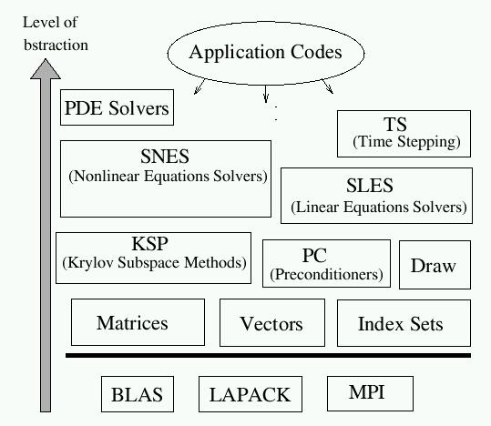
PETSc….continued
Schematic diagram showing different components of the PETSc library, categorized by the level of abstraction.
User code uses PETSc at the desired level of abstraction

Slide 16
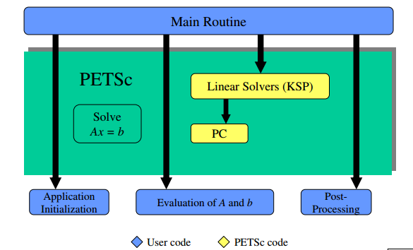
PETSc….a simple example
A simple example of solving a linear system using a Krylov subspace solver. Notice that we are working at a very higher level of abstraction while running an MPI Parallel job

Slide 17
How to choose a Tool/Library/Framework
Evaluating several packages before picking one
Does it do what you think it does?
Does it have a usable interface?
Is it well documented?
Is it MPI Parallel? OpenMP parallel? Thread safe?
Does it have support? Is it extensible? Is it portable?
Does the package integrate well with existing code?
Is it open-source? Free? Available? Dead?
When you use a package, it becomes YOUR code

Slide 18
Final Remarks
Don’t re-invent the wheel. Chances are that someone already did it…and did it well enough
Reduce development type by focusing on specifics
Read the license / type of license carefully before you use the code. Some licenses require you to share your source code when you publish your work
Always give due credits and reference other people’s work if you use it in yours
Contribute to the society if you find something better

Slide 19
Thank you for your attention!
Merry Christmas!!
Ravikishore Kommajosyula

